Slide 1

Career Academy of Business Administration & Management
An Academy of Distinction – with Distinguished Honors
Fall 2025 Town Hall

Slide 2
CABAM Staff
Kevin Schachter | schachterk@pcsb.org | Accounting Applications I, Legal Aspects of Business, Business & Entrepreneurial Principles, Introduction to Hospitality & Tourism, Technology for Hospitality & Tourism, Hospitality & Tourism Marketing Management, Hospitality & Tourism Internship, Hospitality & Tourism Entrepreneurship, Business Ed. Directed Study. ***Future Business Leaders of America(FBLA), ***Technology Coordinator/phuhs.org Webmaster, ***Department Chair
Dzindzi Asamoah-Wade | asamoahwaded@pcsb.org | Advanced Information Technology, Foundations of Programming, AP Computer Science Principles, Digital Design 1-3, ***National Technical Honor Society, ***Girls Who Code
Randy Homa | homar@pcsb.org | Sports, Recreation & Entertainment Marketing I – III: Personal Finance

Slide 3
What is CABAM?
A career themed academy offering a sequence of courses providing rigorous and relevant content aligned with challenging academic standards and technical knowledge and skills needed to prepare for further education and careers.
CABAM Gives you a head start on life after High School.

Slide 4
CABAM Mission
Empowering Success

Slide 5
CABAM Vision Statement
To provide students with rigorous and relevant business concepts and skills, through education and experiences, that are vital for success in life.

Slide 6
CABAM Values: G.R.I.T.
G – Growth:
  Improve a little every day
R – Respect:
  Build character through how you treat others
I – Integrity:
  Small honest choices build trustworthiness
T – Tenacity:
  Stick with the hard stuff — get stronger

Slide 7
Career Academy of
Business Administration & Management
Text to 81010 for CABAM Reminders
Grade 9: @CABAM29
Grade 10: @CABAM28
Grade 11: @CABAM27
Grade 12:@CABAM26
phuhscabam on Instagram
facebook.com/cabamphuhs/

Slide 8
What do we do?
Field Trips/Business Travel
Job Shadow
Incentives
Seminars/Business Lecture Series
Industry Certifications
Career & College Fair
Town Hall
Professional Attire
Career Preparation
Mock Interviews
Resume Help
Community Service Project/Bright Futures Hours
Community Advisory Board
Clubs & Organizations

Slide 9
Professional Attire
Professional Dress days allow students to develop an awareness of the image your appearance projects, as well as to learn and practice the finer points of making great first impressions and dressing for success. You will also receive many tips for dressing professionally for special situations like job interviews, business meetings and even business trips.
This is a graded assignment, once per grading period.
  Wednesday, September 17, 2025
  Tuesday, October 28, 2025
  Spring dates TBD

Slide 10
Job Shadow
A short-term work-based educational experience which introduces students to a particular job or career by pairing them with an employee of a business, industry or agency. By following or "shadowing" that employee for a day, students become familiar with the duties associated with that occupation, the physical setting of the occupation, and the compatibility of the occupation with their own career goals.
Tuesday, November 18, 2025
Spring TBD

Slide 11
Industry Certifications
Last year More than 125 CABAM students improved their resumes by earning over 300 globally recognized credentials with a wide variety of certifications. They also helped boost the school grade, and some earned additional college credits and scholarships and even helped earn money for CABAM (Which we spend on you!)
Certification Days will begin in October and continue through May (11-209)

Slide 12
Career & College Fair/Mock Interviews
This event is an opportunity for you to meet with potential employers, and practice networking, filling out job applications, and even interviewing. Many students receive employment or arrange to complete volunteer hours through these events.
Mock Interviews: TBD – October, April
Career Fair: Spring 2025

Slide 13
Seminars & Business Lecture Series
Business Lecture Series & Seminars
This long running event occurs each semester, where local businesspeople present practical concepts and skills, aimed at helping you prepare for College, Careers, and Life. Past topics have included; Time Management, Math in the Real World, Employer Expectations, Accountability, and Job Interviews.
Dress for Success: Wednesday, September 17, 2025
Funding the Future Financial Literacy: October 7, 2025

Slide 14
Community Service Project
Designed to: Give students opportunities to earn volunteering hours for Bright Futures; teach Corporate Social Responsibility (CSR); and to foster community in the program and school.
Over the past 15 years CABAM Students have raised over $100,000 and volunteered many thousands of hours for several worthy causes.
Keep Florida Beautiful
FEAST (Food Pantry)
Suncoast Animal Shelter
Palm Harbor Chamber of Commerce
American Cancer Society – Relay for Life

Slide 15
Community Advisory Board
A group of business partners, business owners & managers, entrepreneurs, parents, teachers, and students who assist in adding value to what we can offer you, by organizing the programs discussed today, as well as offering job shadow opportunities, internships, mentoring and more.
Meeting Dates: (2:30-3:30 in Principal’s Conference Room)
September 8, November 17, January 12, March 9

Slide 16
CABAM Student Advisory Committee
Are you a passionate and driven student interested in shaping the future of our Business Program while earning valuable volunteer community service hours? Here's your chance to make a real impact and pave the way for positive change!
The Student Advisory Committee is a unique opportunity for dedicated students to have a direct say in the development and enhancement of CABAM, including the programs we offer, curriculum we utilize, the activities we participate in, and the causes we get involved in. Your insights, ideas, and feedback will help us create an even more engaging and enriching learning experience for all CABAM students.
See Mr. Schachter with questions

Slide 17
Future Business Leaders of America (FBLA)
Future Business Leaders of America is a co-curricular student run organization designed to teach students about business while developing leadership, communication and team skills. All CABAM students are strongly encouraged to participate.
Information on School Website under Clubs & Activities
Next General Meeting: 9/9/2025, 2:05, 11-201

Slide 18
National Technical Honor Society (NTHS)
National Technical Honor Society is a club that recognizes students who have carried an overall 3.0 GPA or higher in their overall academic coursework as well as within their CTE pathway or major. This club has awarded millions in scholarships and comes with a host of other perks for its members. “NTHS membership is the beginning of building a life and career upon a foundation of skill, service, responsibility, citizenship, scholarship, leadership, and honesty”.
Contact either Ms. Asamoah-Wade or Ms. Webb to see if you’re eligible!

Slide 19
Girls Who Code
Now in their sixth year operating at PHUHS. Students create a safe space on campus for aspiring female and female identifying coders and computer scientists to learn together and collectively work towards closing the gender gap in STEM. Members participate in team building exercises, hear from guest speakers who are shaking up the STEM fields and leaders in the CS community, and begin the building blocks of coding.

Slide 20

TEDxYouth@PHUHS
Student run TEDxYouth Event
Informational Meeting Thursday, September 4, 2:00 in 11-201
  Positions Needed:
    Lead Curator
      Curators
    Executive Producer
    Event Manager
    Sponsorship & Budget Manager
    Communications, Editorial & Marketing Director
      Lead Designer
      Website Manager
    Video & Production Manager

Slide 21
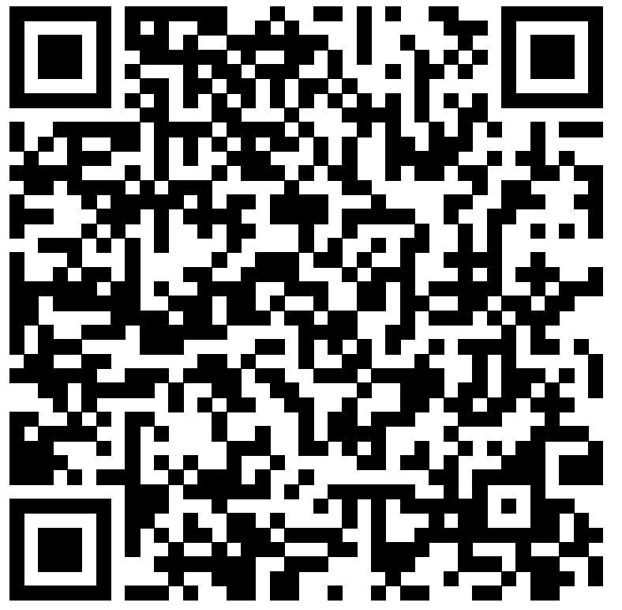
Field Trips:
Benchmark International (Amelie) Arena
Florida Restaurant Show
Innisbrook Resort
Hyatt Regency
FBLA National Conferences:
  2026: San Antonio, TX; 2027: Nashville, TN; 2028: Columbus, OH
Synapse Summit
Senior Trip – Hollywood Studios – April 2, 2026
CABAM: “Business in…Seattle” February 12-16, 2026
Business in JAPAN: Spring Break – March 2026

Slide 22
Incentives
Scholarships (Gold Seal/Bright Futures)
  The Tim & Susan Bryce Scholarship $1,000
College Credit (SPC)
Reduced Cost on Field Trips
Grad Cords for Program Completers
T-Shirts
Prizes, Gift Cards/Certificates, Swag

Slide 23
CABAM Programs
Hospitality & Tourism Management
Digital Design (H)
Digital Design I (H)
Business Management & Analysis
Digital Design II (H)
Introduction to Hospitality & Tourism (C)
Technology for Hospitality & Tourism
Legal Aspects of Business (H)
Accounting I (H)
Sports, Entertainment & Recreation Marketing
Sports, Entertainment & Recreation Essentials
Sports, Entertainment & Recreation Applications
Sports, Entertainment & Recreation Management (H)
Hospitality & Tourism Management Marketing (H)
Sports, Entertainment & Recreation Internship
Digital Design III (H)
Business & Entrepreneurial Principles (H)(C)
Advanced Information Technology
AP Computer Science Principles
AP Computer Science A (Online)
Digital Design IV (H)
Foundations of Programming
Hospitality Entrepreneurship (H)
Computer Science
Digital Information Technology (MS)(C)

Slide 24
CABAM Standalone Courses
Personal Financial Literacy
Business Education Directed Study
Hospitality & Tourism Internship
Sports, Entertainment & Recreation Marketing Internship

Slide 25
Classes with room to spare:
Period 1
  APCSP
  Accounting Applications
  Sports, Entertainment & Recreation Marketing
Period 2
  Business & Entrepreneurial Principles
  Foundations of Programming
Period 3
  Advanced IT
  Business & Entrepreneurial Principles
Period 4
  Digital Design I
  Intro to Hospitality & Tourism
Period 5
  Intro to Hospitality & Tourism
  Digital Design 2, 3, 4
Period 6
  Legal Aspects of Business
  APCSP

Slide 26
Upcoming Opportunities/Events
Parent’s Night: 8/26 6:00-8:00 p.m.
TEDxYouth@PHUHS: Thursday, September 4
CABAM Community Advisory: September 8
FBLA – Next General Meeting After School 9/9
CABAM Parent Summit: 9/10 7:00pm–8:30pm

Slide 27
Common Career Technical Core
Career Ready Practices
Career Ready Practices describe the career-ready skills that students should develop. These practices are not exclusive to a class, Career Pathway, program of study, discipline or level of education. Career Ready Practices should be taught and reinforced in all career exploration and preparation programs with increasingly higher levels of complexity and expectation as a student advances through a program of study.

Slide 28
Common Career Technical Core
Career Ready Practices
Act as a responsible and contributing citizen and employee.
Apply appropriate academic and technical skills.
Attend to personal health and financial well-being.
Communicate clearly, effectively and with reason.
Consider the environmental, social and economic impacts of decisions.
Demonstrate creativity and innovation.
Employ valid and reliable research strategies.
Use critical thinking to make sense of and persevere in solving problems.
Model integrity, ethical leadership and effective management.
Plan education and career paths aligned to personal goals.
Use technology to enhance productivity.
Work productively in teams while using cultural/global competence.

Slide 29

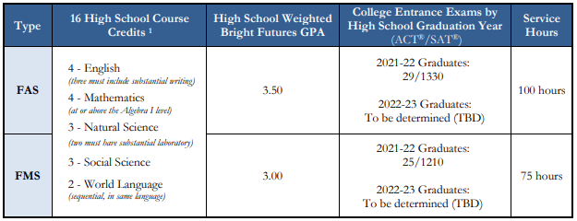

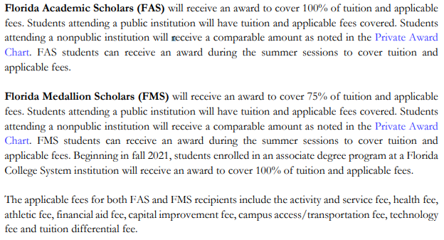
Academic and Medallion Scholarships
Type | High School Course | HS GPA | ACT / SAT Scores | Service Hours | Award
FAS | 4 – English 4 – Mathematics 3 – Natural Science 3 – Social Science 2 – World Language | 3.50 | 2021–22 Graduates: 29 / 1340 2022–23 Graduates: TBD | 100 hours | 100%
FMS |  | 3.00 | 2021–22 Graduates: 25 / 1210 2022–23 Graduates: TBD | 75 hours | 75%
Bright Futures
Source: https://www.floridastudentfinancialaidsg.org/SAPBFMAIN/SAPBFMAIN

Slide 30
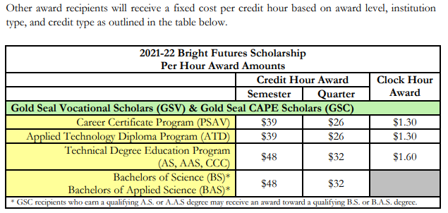
Gold Seal: Vocational (GSV) or CAPE (GSC)
GSV and GSC award recipients will receive a fixed cost per credit hour based on award level, institution type, and credit type as specified in the BF Student Handbook, chapter 2.
Gold Seal awards (GSC/GSV) may only be used at postsecondary institutions that offer an applied technology diploma, technical degree education program (associate in science-A.S. or associate in applied science-A.A.S.), or a career certificate program. GSC recipients who earn a qualifying A.S. or A.A.S. degree may be funded for a qualifying B.S. or B.A.S. bachelor’s degree.
Bright Futures
Notes:
Questions for BF:
Do the CAPE certifications have to be from the same Associate Degree Program? No, they just need the articulated credit.
Does the student have to be enrolled in the Associate Degree program that aligns with their certifications? No
How is this impacted with dual enrollment? No impact if student is enrolled in HS and earns certification.
Can the certifications be earned in middle school? [assuming yes, but confirm with Timberly]

Slide 31
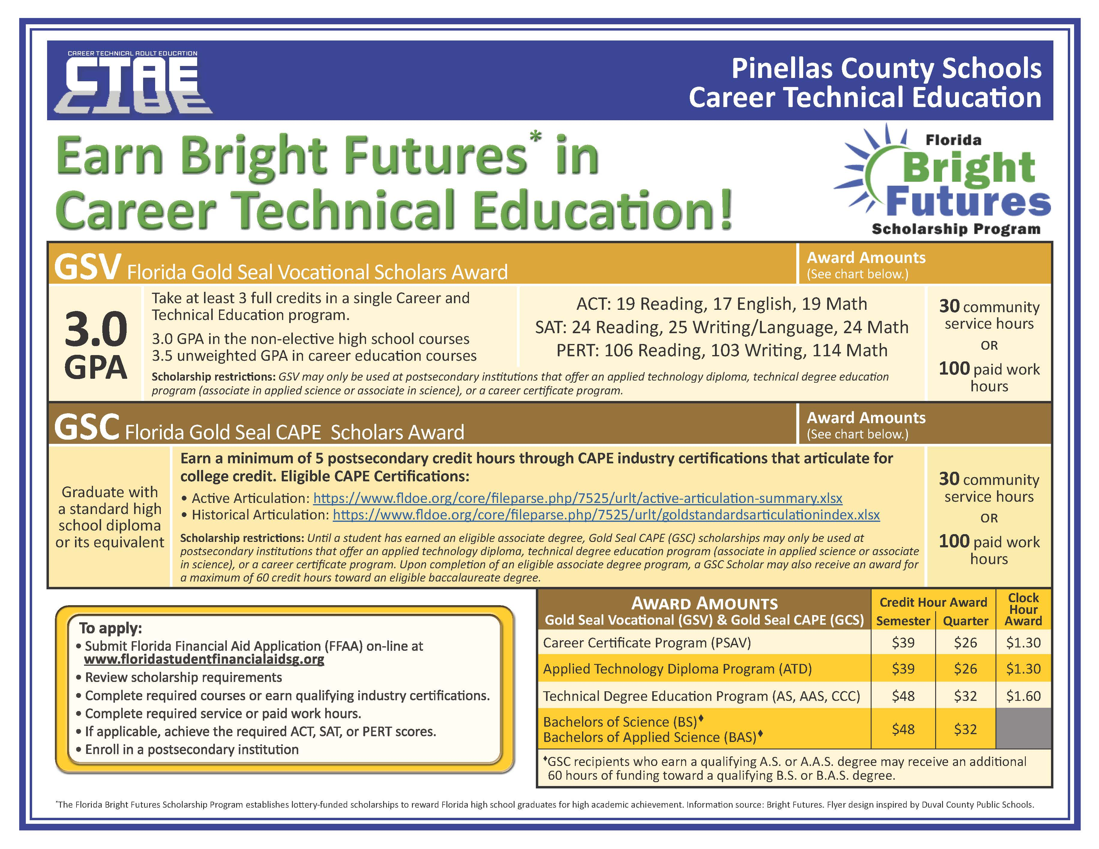

Slide 32
Articulated Certifications (examples)
This list is only a few of the CAPE certifications that have articulated credit.
FDOE Cert. Code | Certification Title | # of Credits Articulated
ADOBE023 | Adobe Certified Professional in Video Design (Requires Premiere Pro and After Effects or Photoshop) | 4
ADOBE024 | Adobe Certified Professional in Visual Design (Requires Photoshop and Illustrator or InDesign) | 3
AIOPB001 | Certified Bookkeeper | 3
PROSO003 | Certified Internet Web (CIW) E-Commerce Specialist | 3
PROSO017 | Certified Internet Web (CIW) JavaScript Specialist | 3
COMPT007 | CompTIA Project+ | 3
COMPT008 | CompTIA Security+ | 3
ICOEC005 | EC-Council Cyber Forensics Associate | 3
ICOEC006 | EC-Council Ethical Hacker Associate | 3
MICRO089 | Microsoft Certified Solutions Expert (MCSE) - Data Platform | 3
MICRO069 | Microsoft Office Specialist (MOS) Bundle Certification (3 of 6) | 3
MICRO017 | Microsoft Office Specialist Master | 3
MICRO080 | Microsoft Technology Associate (MTA) - HTML5 Application Developer Fundamentals | 3
MICRO104 | Microsoft Technology Associate (MTA) - Introduction to Programming Using JavaScript | 3
MICRO112 | Microsoft Technology Associate (MTA) - Introduction to Programming Using Python | 3
INTUT001 | QuickBooks Certified User | 3
UNITY001 | Unity Certified Associate | 6
UNITY002 | Unity Certified User: Programmer | 6
Bright Futures – Gold Seal CAPE
Eligible CAPE Certifications: Active Articulation Agreements Summary www.fldoe.org/core/fileparse.php/7525/urlt/active-articulation-summary.xlsx

Slide 33
Through the articulation agreement with St. Petersburg College, students will earn college credit if specified criteria are met.
For current course articulation and requirements, visit www.spcollege.edu/connect; select Pinellas County High School – Academy College Credit.
Each PCS high school’s CTE program is listed with the applicable SPC articulation.
SPC articulation is subject to change.
SPC Articulation

